Slide 1
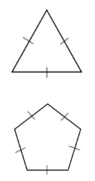

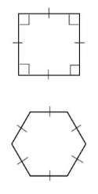
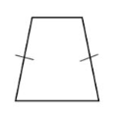

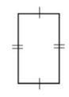
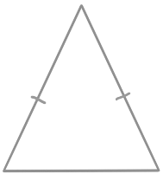




Subtopic G1.9 – Understand and use the sum of exterior angles of any polygon
LEARNING OUTCOME: To be able to apply the properties of exterior angles to solve problems
Objectives:
Keywords:
- Polygon
- Interior
- Exterior
- Regular
- Irregular
To understand the sum of exterior angles in any polygon.
To be able to use the exterior angle sum to find missing angles
To be able to use the exterior angle sum to calculate the number of sides in a polygon.
Definition
Characteristics
A 2D Shape with three or more straight line sides. All sides are the same length. The interior angles are equal in size, and the exterior angles are equal in size. ​
Enclosed shape of straight sides
Sides are equal length
Angles are equal between the sides
No curved lines
Examples
Regular Polygon
Non - Examples
Definition
Characteristics
A 2D Shape with three or more straight line sides. The sides are different lengths. The interior angles are different sizes, and the exterior angles are different sizes. ​​
Enclosed shape of straight sides
Sides are different lengths
Angles are different sizes between the sides
No curved lines
Examples
Irregular Polygon
Non - Examples
‹#›

Slide 2







Identifying regular and irregular polygons
 | Example 1 – I do… | Example 2 – We do… | Example 3 – You do…
Steps | Identify whether each shape below is a polygon or not. If it is a polygon, state whether it is a regular or irregular polygon. | Identify whether each shape below is a polygon or not. If it is a polygon, state whether it is a regular or irregular polygon. | Identify whether each shape below is a polygon or not. If it is a polygon, state whether it is a regular or irregular polygon.
1) Is it a 2D shape with three or more straight line sides? If yes, the shape is a polygon. 2) Are all the sides the same length? Are all the angles the same size? If so, the polygon is regular.
Not a polygon
Polygon - regular
Not a polygon
Polygon - regular
Polygon - irregular
Polygon - regular
Independent Practice
Question 1. For each shape, decide whether it is a polygon or not. For those that are polygons, decide whether they are regular or irregular polygons.
a) |  | Polygon/ Not a polygon | Regular/ Irregular/ NA
b) |  | Polygon/ Not a polygon | Regular/ Irregular/ NA

Slide 3






Question 1 continued.
c) |  | Polygon/ Not a polygon | Regular/ Irregular/ NA
d) |  | Polygon/ Not a polygon | Regular/ Irregular/ NA
e) |  | Polygon/ Not a polygon | Regular/ Irregular/ NA
f) |  | Polygon/ Not a polygon | Regular/ Irregular/ NA
g) |  | Polygon/ Not a polygon | Regular/ Irregular/ NA
h) |  | Polygon/ Not a polygon | Regular/ Irregular/ NA

Slide 4






Question 1 continued.
6cm
i) |  | Polygon/ Not a polygon | Regular/ Irregular/ NA
j) |  | Polygon/ Not a polygon | Regular/ Irregular/ NA
k) |  | Polygon/ Not a polygon | Regular/ Irregular/ NA
l) |  | Polygon/ Not a polygon | Regular/ Irregular/ NA
m) |  | Polygon/ Not a polygon | Regular/ Irregular/ NA
n) |  | Polygon/ Not a polygon | Regular/ Irregular/ NA
6cm
6cm
144º
144º
6cm
144º
144º
6cm
6cm
144º
144º
6cm
144º
144º
6cm
144º
144º
6cm
6cm
7cm
7cm
7cm
135º
135º
7cm
135º
135º
7cm
135º
135º
7cm
135º
135º
7cm
7cm

Slide 5
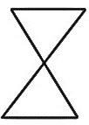
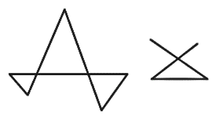
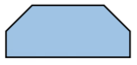

Question 1 continued.
o) |  | Polygon/ Not a polygon | Regular/ Irregular/ NA
p) |  | Polygon/ Not a polygon | Regular/ Irregular/ NA
q) |  | Polygon/ Not a polygon | Regular/ Irregular/ NA
Question 2. Answer the following questions:
a)
Matty says: “My polygon is a regular hexagon because some of the sides are the same length and some of the angles are the same size” Do you agree with Matty? You must explain your answer. | No. For the hexagon to be regular, all sides must be the same length (not just some).
b)
Sunita says: “A rectangle is a regular polygon because it has 4 angles of equal size”. Do you agree with Sunita? You must explain your answer. | No. The side lengths must also all be equal, but this is not true for a rectangle.

Slide 6
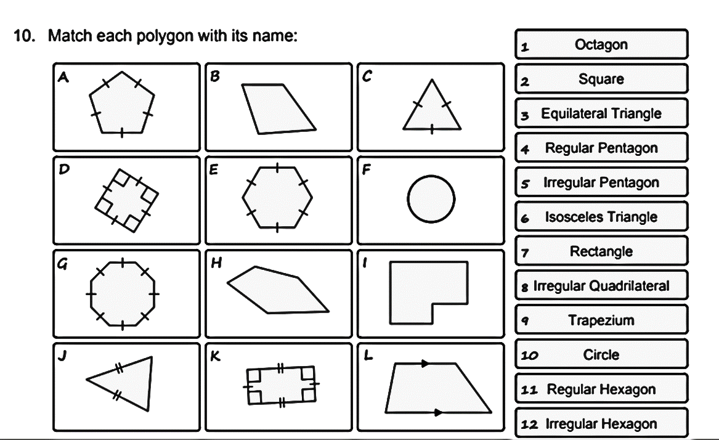
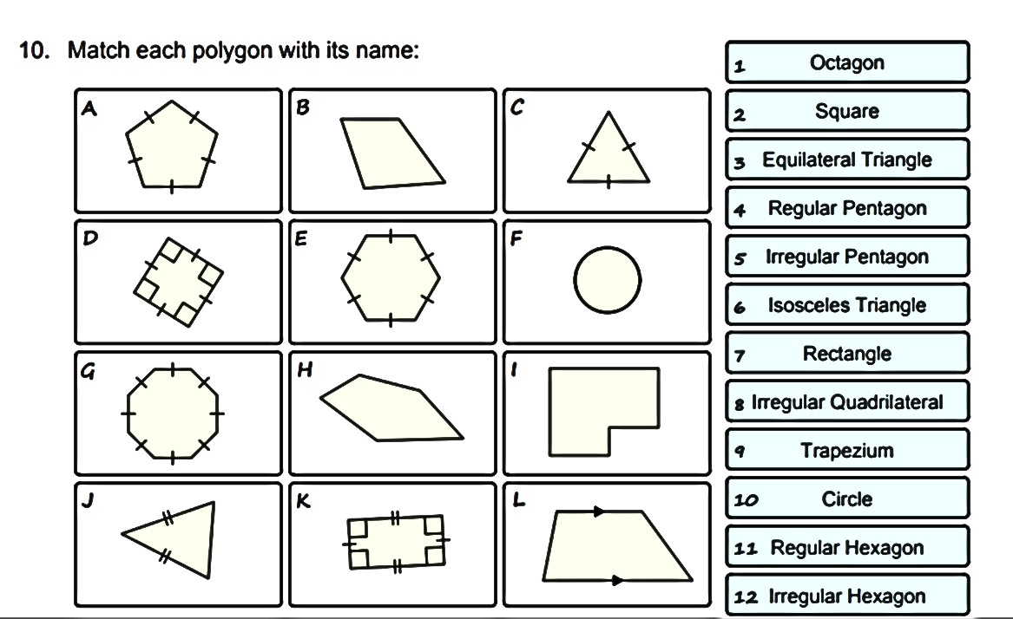
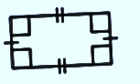
Question 3. Match each polygon with its name:
Octagon | Equilateral Triangle | Square | Regular Pentagon | Irregular Pentagon | Isosceles Triangle
Rectangle | Irregular Quadrilateral | Trapezium | Circle | Regular Hexagon | Irregular Hexagon
a) | b)
Regular pentagon | Irregular quadrilateral
c) | d)
Equilateral Triangle | Square
e) | f)
Regular hexagon | Circle
g) | h)
Octagon | Irregular pentagon
i) | j)
Irregular hexagon | Isosceles triangle
k) | l)
Rectangle | Trapezium

Slide 7
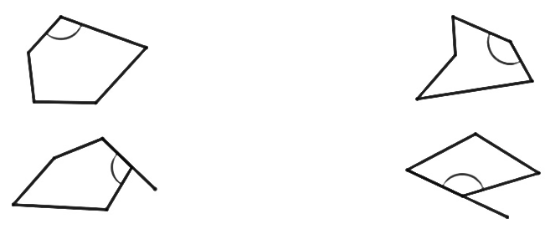
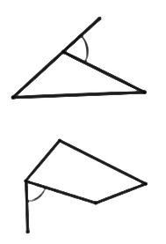
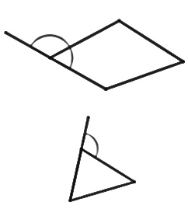
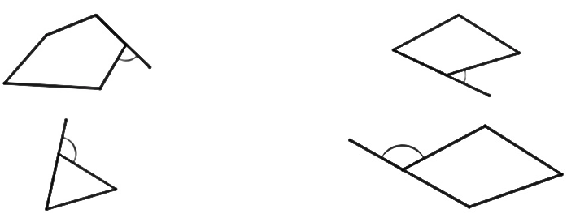
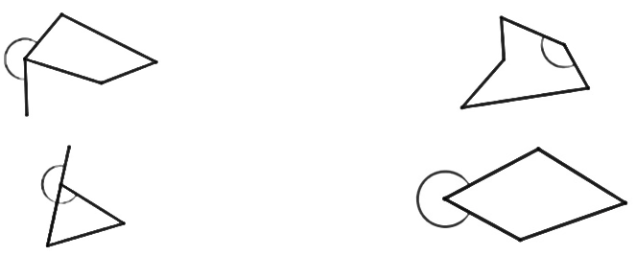


Definition
Characteristics
An angle on the inside of a polygon. The angle is formed where two sides of the polygon meet.​
Formed between two side lengths
Interior and exterior angles sum to 180°
Examples
Interior Angle
Non - Examples
Definition
Characteristics
An angle on the outside of a polygon. The angle is formed between an extended side and the adjacent side.​
Formed between a side-length and an extension
Interior and exterior angles sum to 180°
Exterior angles sum to 360º
Examples
Exterior Angle
Non - Examples
Identifying interior and exterior angles
 | Example 4 – I do… | Example 5 – We do… | Example 6 – You do…
Steps | Identify whether each angle is interior, exterior or neither. | Identify whether each angle is interior, exterior or neither. | Identify whether each angle is interior, exterior or neither.
1) Is the angle inside the polygon, formed where two sides meet? If so, it is an interior angle. 2) Is the angle outside the polygon, formed between a side length and a straight line extension? If so, it is an exterior angle.
Exterior
Neither
Interior
Interior
Exterior
Neither

Slide 8
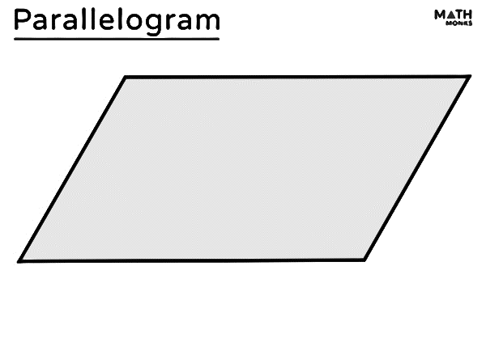

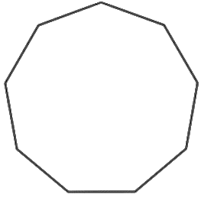

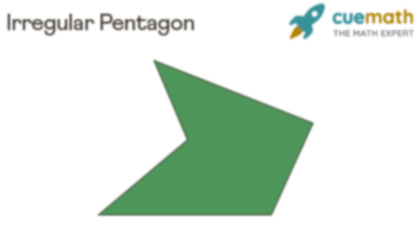
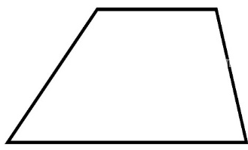

Independent Practice
Question 4. For each angle, decide whether it is an interior angle, an exterior angle or neither.
a)
b)
c)
d)
e)
f)
g)
h)
Interior/ Exterior/ Neither
Interior/ Exterior/ Neither
Interior/ Exterior/ Neither
Interior/ Exterior/ Neither
Interior/ Exterior/ Neither
Interior/ Exterior/ Neither
Interior/ Exterior/ Neither
Interior/ Exterior/ Neither

Slide 9


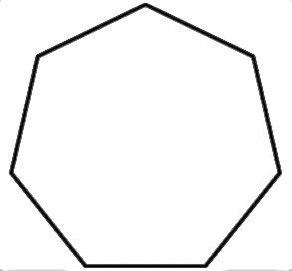
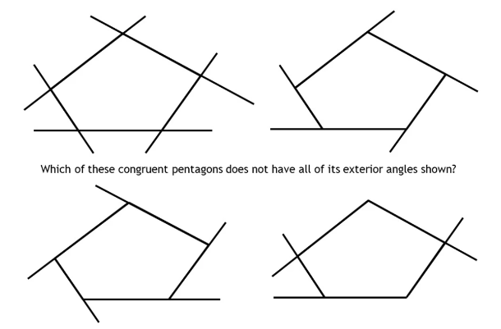
Question 4 continued.
i)
j)
k)
l)
Interior/ Exterior/ Neither
Interior/ Exterior/ Neither
Interior/ Exterior/ Neither
Interior/ Exterior/ Neither
Question 5. Which of these congruent pentagons does not have all of its exterior angles shown?
D
A
B
C
D
‹#›

Slide 10



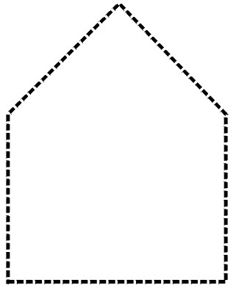
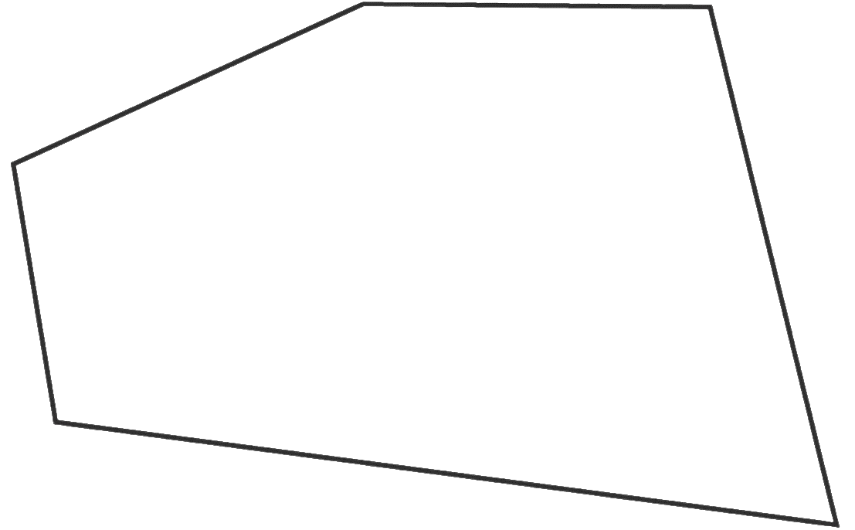
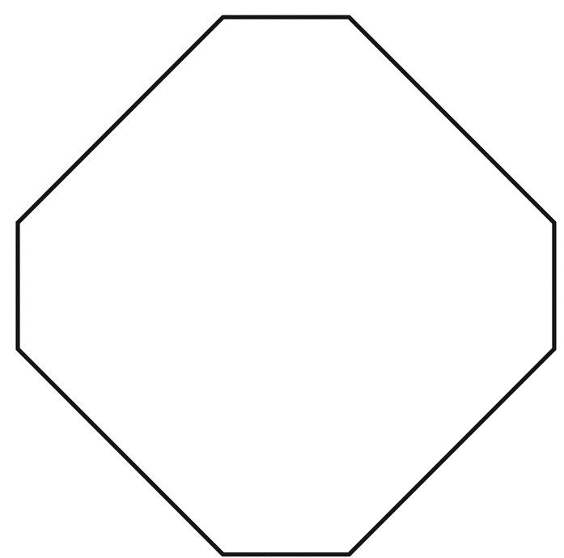



Finding an exterior angle
The sum of exterior angles of a polygon is 360°
 | Example 7 – I do… | Example 8 – We do… | Example 9 – You do…
Steps | Below is a regular hexagon. Calculate the value of the exterior angle, x. | Below is a regular pentagon. Calculate the value of the exterior angle, y. | Below is a regular octagon. Calculate the value of the exterior angle, z.
1) Divide the sum of exterior angles by the number of exterior angles (number of sides).
z
y
x
 | Example 10 – I do… | Example 11 – We do… | Example 12 – You do…
Steps | Below is an irregular hexagon. Calculate the value of the exterior angle, x. | Below is an irregular pentagon. Calculate the value of the exterior angle, y. | Below is an irregular octagon. Calculate the value of the exterior angle, z.
1) Subtract all given angles from 360º.
95º
80º
30º
55º
40º
x
60º
z
75º
41º
50º
38º
90º
y
50º
52º
90º
45º

Slide 11
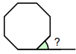



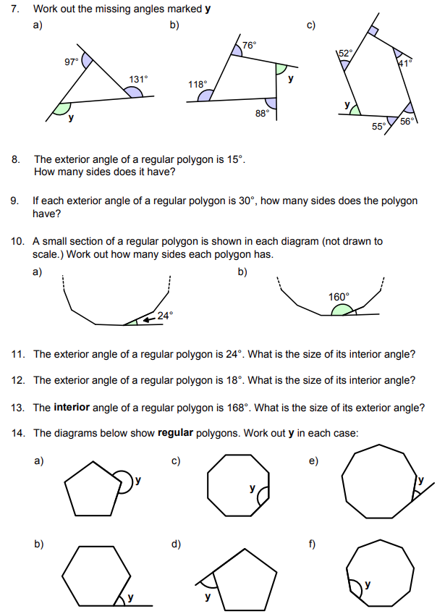
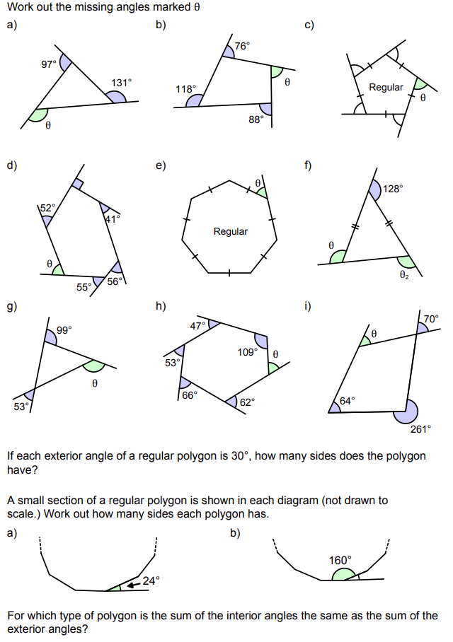




Independent Practice
Question 6. Fing the missing angle in each of the following problems:
a) | b)
Regular octagon | Regular pentagon
c) | d)
Regular pentagon | Regular heptagon
e) | f)
Regular nonagon | Regular hexagon

Slide 12






Question 6 continued.
g) | h)
A regular decagon has 10 sides. What is the size of each exterior angle? | A regular nonagon has 9 sides. What is the size of each exterior angle?
i) | j)
k) | l)

Slide 13
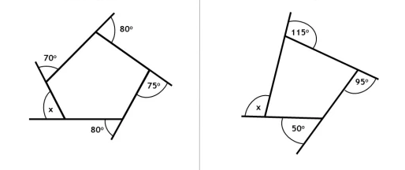


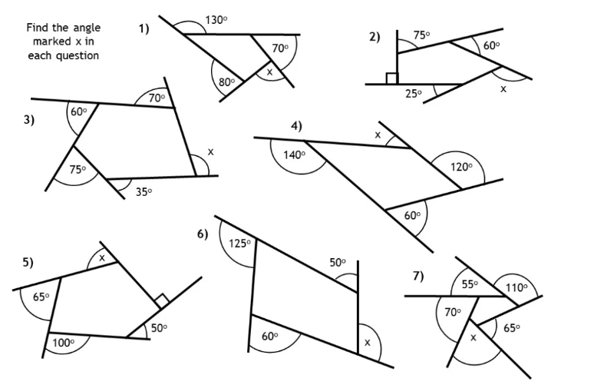




Question 6 continued.
m) | n)
o) | p)
q) | r)

Slide 14
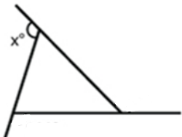
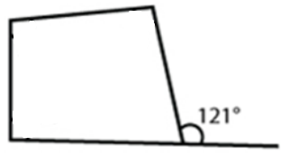
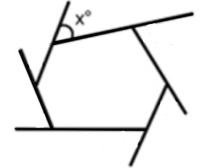






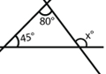
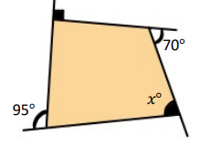
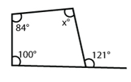



Finding an exterior angle, given the interior angle, and vice-versa
interior angle + exterior angle = 180°
 | Example 13 – I do… | Example 14 – We do… | Example 15 – You do…
Steps | Calculate the exterior angle, x. | Calculate the interior angle, y. | Calculate the exterior angle, x.
 | Example 16 – I do… | Example 17 – We do… | Example 18 – You do…
Steps | Calculate the exterior angle, x. | Calculate the interior angle, y. | Calculate the exterior angle, x.
1) Use your knowledge of: Interior angle + exterior angle = 180º The sum of all exterior angles is 360º Angles in a triangle sum to 180º Angles in a quadrilateral sum to 360º to solve these problems.

Slide 15
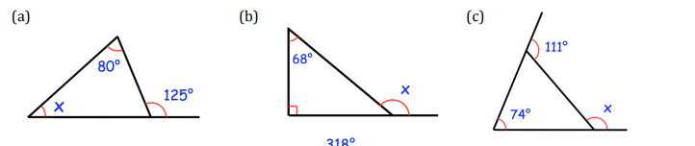


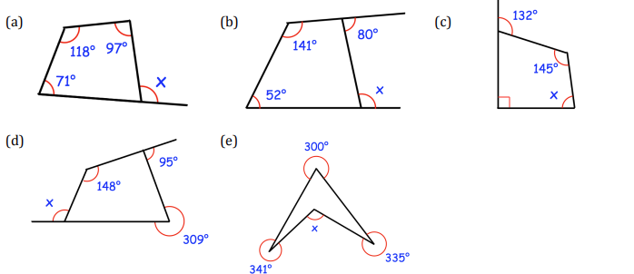




Independent Practice
Question 7. Find the missing angles in each of the following problems:
a) | b)
c) | d)
e) | f)

Slide 16
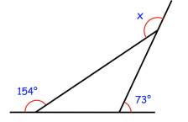


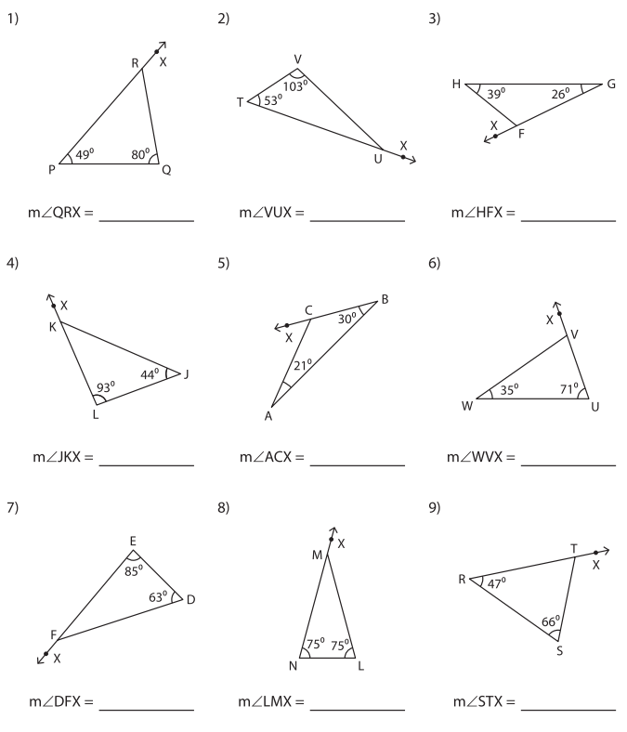


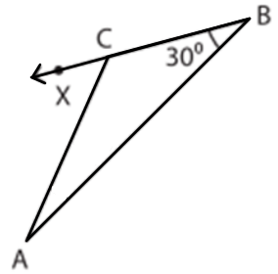

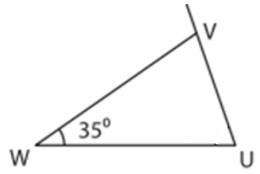



Question 7 continued.
g) | h)
i) | j)
k) | l)

Slide 17
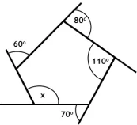


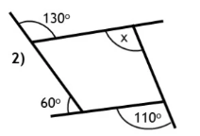
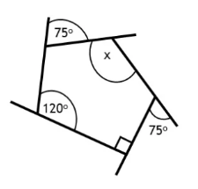


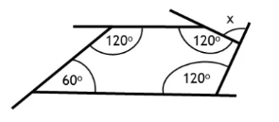
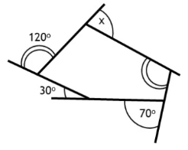


Question 7 continued.
m) | n)
o) | p)
q) | r)

Slide 18
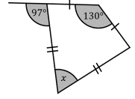
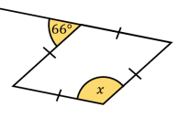


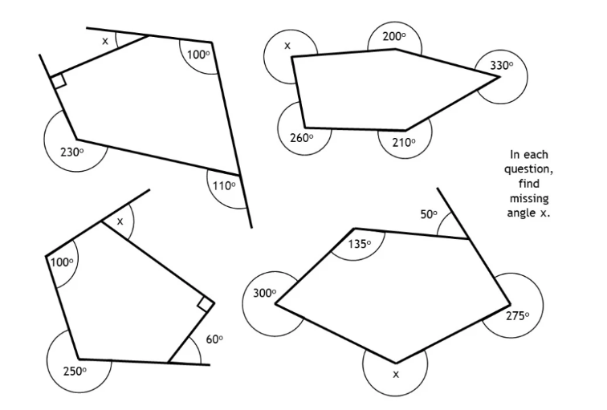




Question 7 continued.
s) | t)
u) | v)
w) | x)

Slide 19











Using the properties of exterior angles to calculate the number of sides a shape has
 | Example 19 – I do… | Example 20 – We do… | Example 21 – You do…
Steps | Below is a section of a regular polygon, showing an exterior angle. How many sides does the polygon have? | Below is a section of a regular polygon, showing an exterior angle. How many sides does the polygon have? | Below is a section of a regular polygon, showing an exterior angle. How many sides does the polygon have?
1) Divide 360º by the exterior angle. This will give the number of sides.
 | Example 22 – I do… | Example 23 – We do… | Example 24 – You do…
Steps | Below is a section of a regular polygon, showing an interior angle. How many sides does the polygon have? | Below is a section of a regular polygon, showing an interior angle. How many sides does the polygon have? | Below is a section of a regular polygon, showing an interior angle. How many sides does the polygon have?
1) Find the exterior angle, by using the fact that an interior angle + an exterior angle = 180º. 2) Divide 360º by the exterior angle. This will give the number of sides.

Slide 20











Independent Practice
Question 8. Each question below shows a section of a regular polygon, with a given exterior angle. How many sides does the polygon have?
a) | b) | c)
d) | e) | f)
Question 9. Answer the following questions.
a) | The exterior angle of a regular polygon is 15º. How many sides does it have? | 24
b) | If each exterior angle of a regular polygon is 30º, how many sides does it have? | 12

Slide 21










Question 10. Each question below shows a section of a regular polygon, with a given interior angle. How many sides does the polygon have?
a) | b) | c)
d) | e) | f)
Question 11. Answer the following questions.
a) | The interior angle of a regular polygon is 165º. How many sides does it have? | 24
b) | If each interior angle of a regular polygon is 172.5º, how many sides does it have? | 48

Slide 22



Question 12. Answer the following questions.
a) Explain why this cannot be an interior angle of a regular polygon. | b) Vinny says that he has drawn a regular polygon with interior angles of 25°. James says that is not possible. Who is correct? You must give a reason for your answer.
If the interior angle was 173, the exterior angle would have to be 7. 360 divided by 7 is 51.428… which is not a whole number of sides. | James. If the interior angle was 25, the exterior angle would have to be 155. 360 divided by 155 is 2.322… which is not a whole number of sides.
c) Ellis says that the diagram below shows an exterior angle of a regular polygon. Is this possible? You must explain your answer. | d) Jamal says that the diagram below shows an exterior angle of a regular polygon. Is this possible? You must explain your answer.
No, because 360 divided by 22 is 16.3636…, which is not a whole number of sides. | Yes, because 360 divided by 24 is 15, meaning it is a regular polygon with 15 sides.
Question 13. Calculate the number of sides in this regular polygon.
 | 15 sides.

Slide 23



Question 14. In the questions below, each diagram shows an angle and a side length of a regular polygon. Calculate the perimeter of each polygon.
a) |  | 60m
b) |  | 70mm
c) |  | 360cm
d) | Calculate the perimeter of a regular polygon that has an edge length of 2cm and an interior angle of 162º. | 40cm
e) | A regular polygon has a perimeter of 180cm and an exterior angle of 10º. How long is each edge in cm? | 5cm
f) | A regular polygon has a perimeter of 12m and an interior angle of 171º. How long is each edge in cm? | 0.3m

Slide 24




Skills Check
Which quadrilateral below is a regular polygon?
What is the correct name for the angle marked p?
Which of these diagrams show a single interior angle?
What is the sum of the exterior angles of this shape?
What is the size of one exterior angle of a regular 12-sided polygon?
30º
150º
36º
360º

Slide 25



Skills Check
What is the size of angle p?
One of the exterior angles of an irregular polygon is 30º. What is the size of the interior angle adjacent to it?
A regular polygon has an exterior angle of 24º. How many sides does it have?
This is part of a regular polygon. How many sides does it have?
Which of the following values cannot be an external angle of a regular polygon?
24
7.5
15
156
10º
18º
30º
48º

